Slide 1
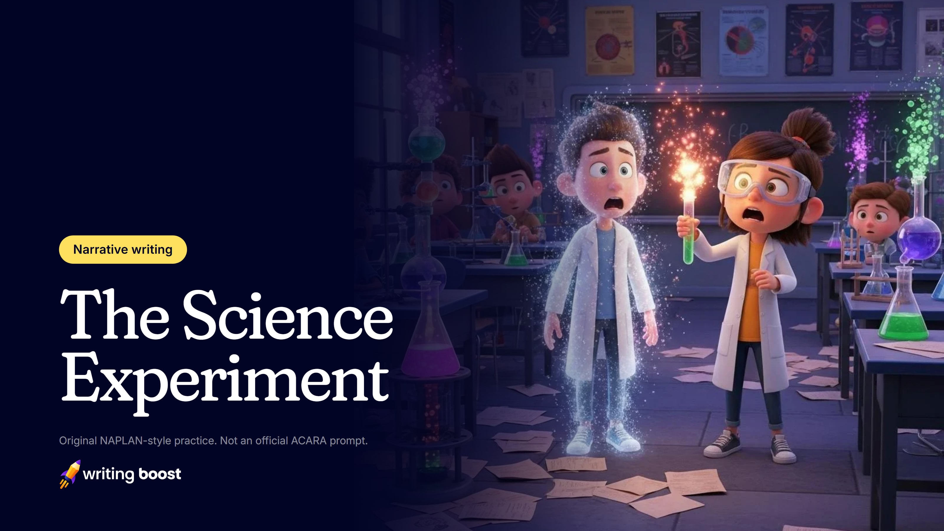
Notes:
The Science Experiment: a narrative writing lesson for Years 3–9, about 55 minutes.
The next two slides are for you: they're set to be skipped when you present.
1. Notice (5 min)
2. Talk it through (10 min)
3. Plan (5 min)
4. Write (35 min)
The printable pack has the task sheet, a planner and a reread checklist to go with these slides.

Slide 2
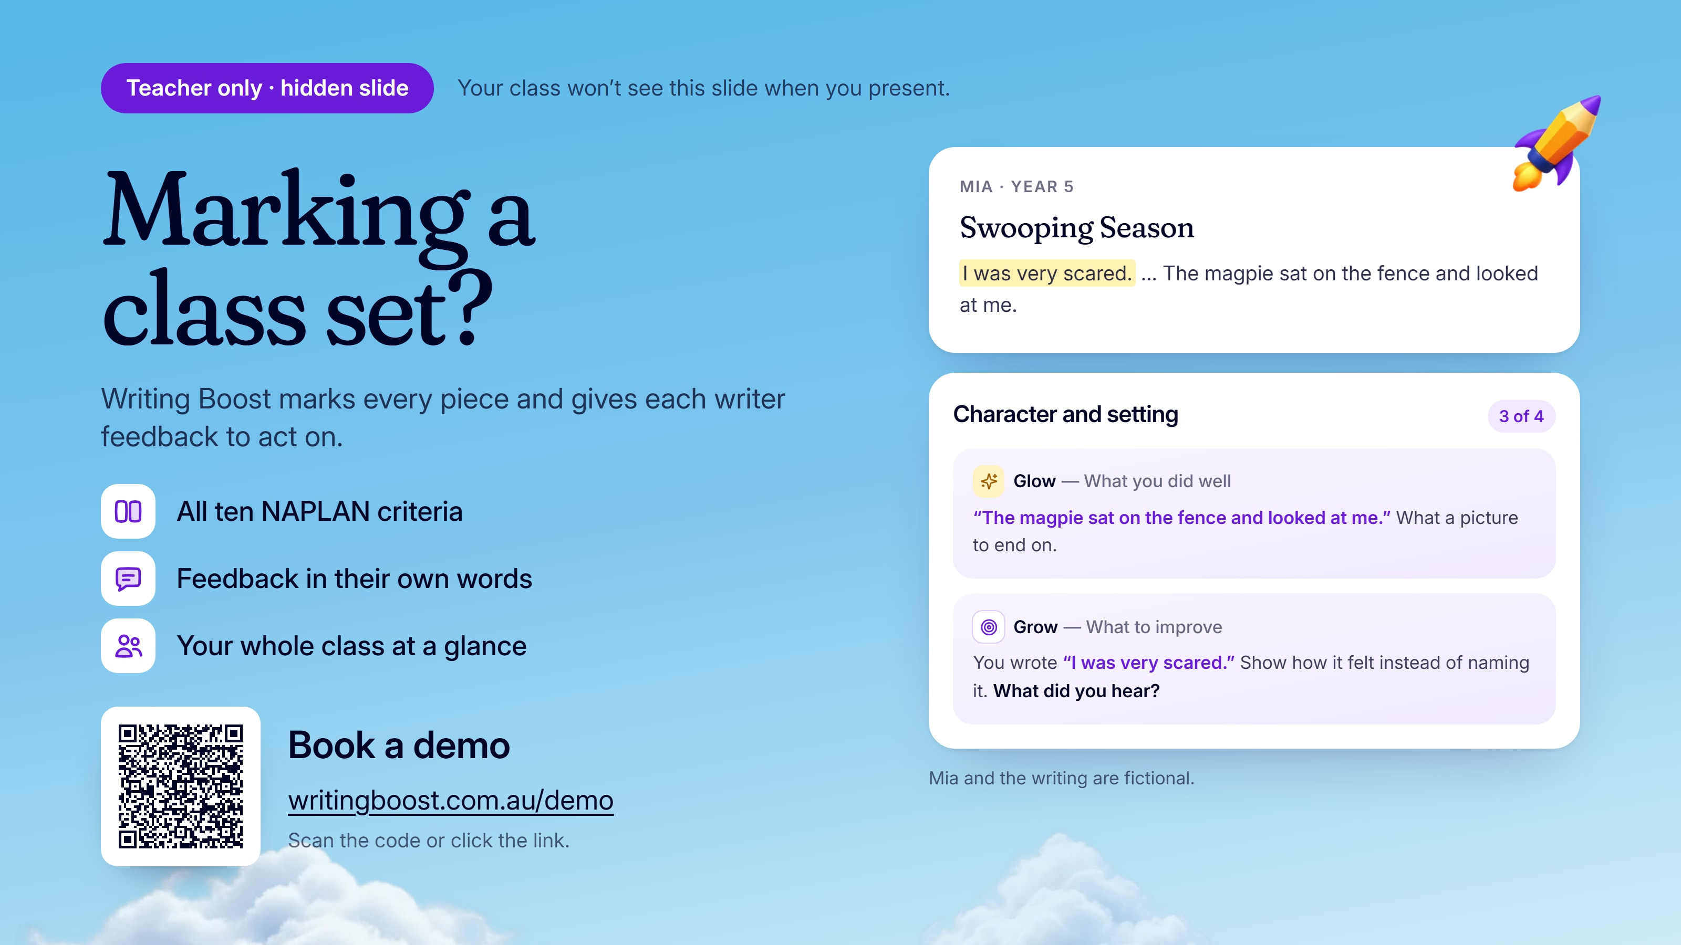
Notes:
This slide is for you, and is set to be skipped when you present.
Mia's narrative piece is a sample, marked by Writing Boost. To see your own class's writing marked on the ten NAPLAN writing criteria, book a demo: https://writingboost.com.au/demo/?utm_source=prompt-pack&utm_medium=slides&utm_campaign=the-science-experiment&utm_content=hidden-slide

Slide 3
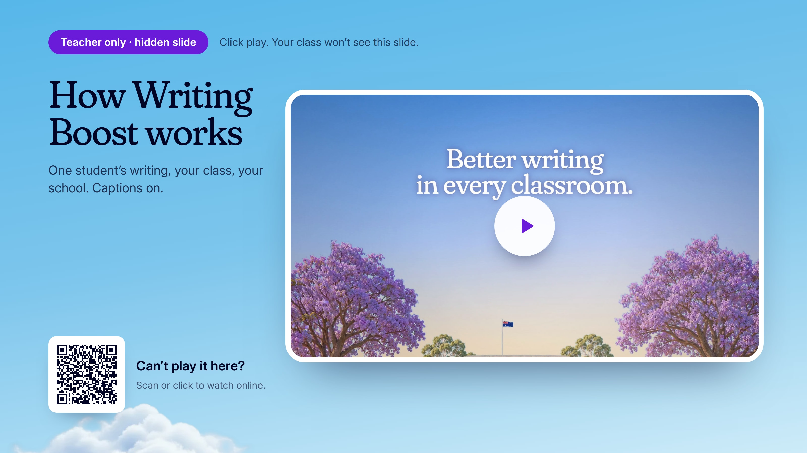

Notes:
This slide is for you, and is set to be skipped when you present.
Click play: How Writing Boost works, with captions. If it won't play here (Google Slides plays only YouTube and Drive videos), watch it online: https://writingboost.com.au/media/homepage-film/writing-boost-homepage-film-v3-short-jacaranda-web-720.mp4

Slide 4
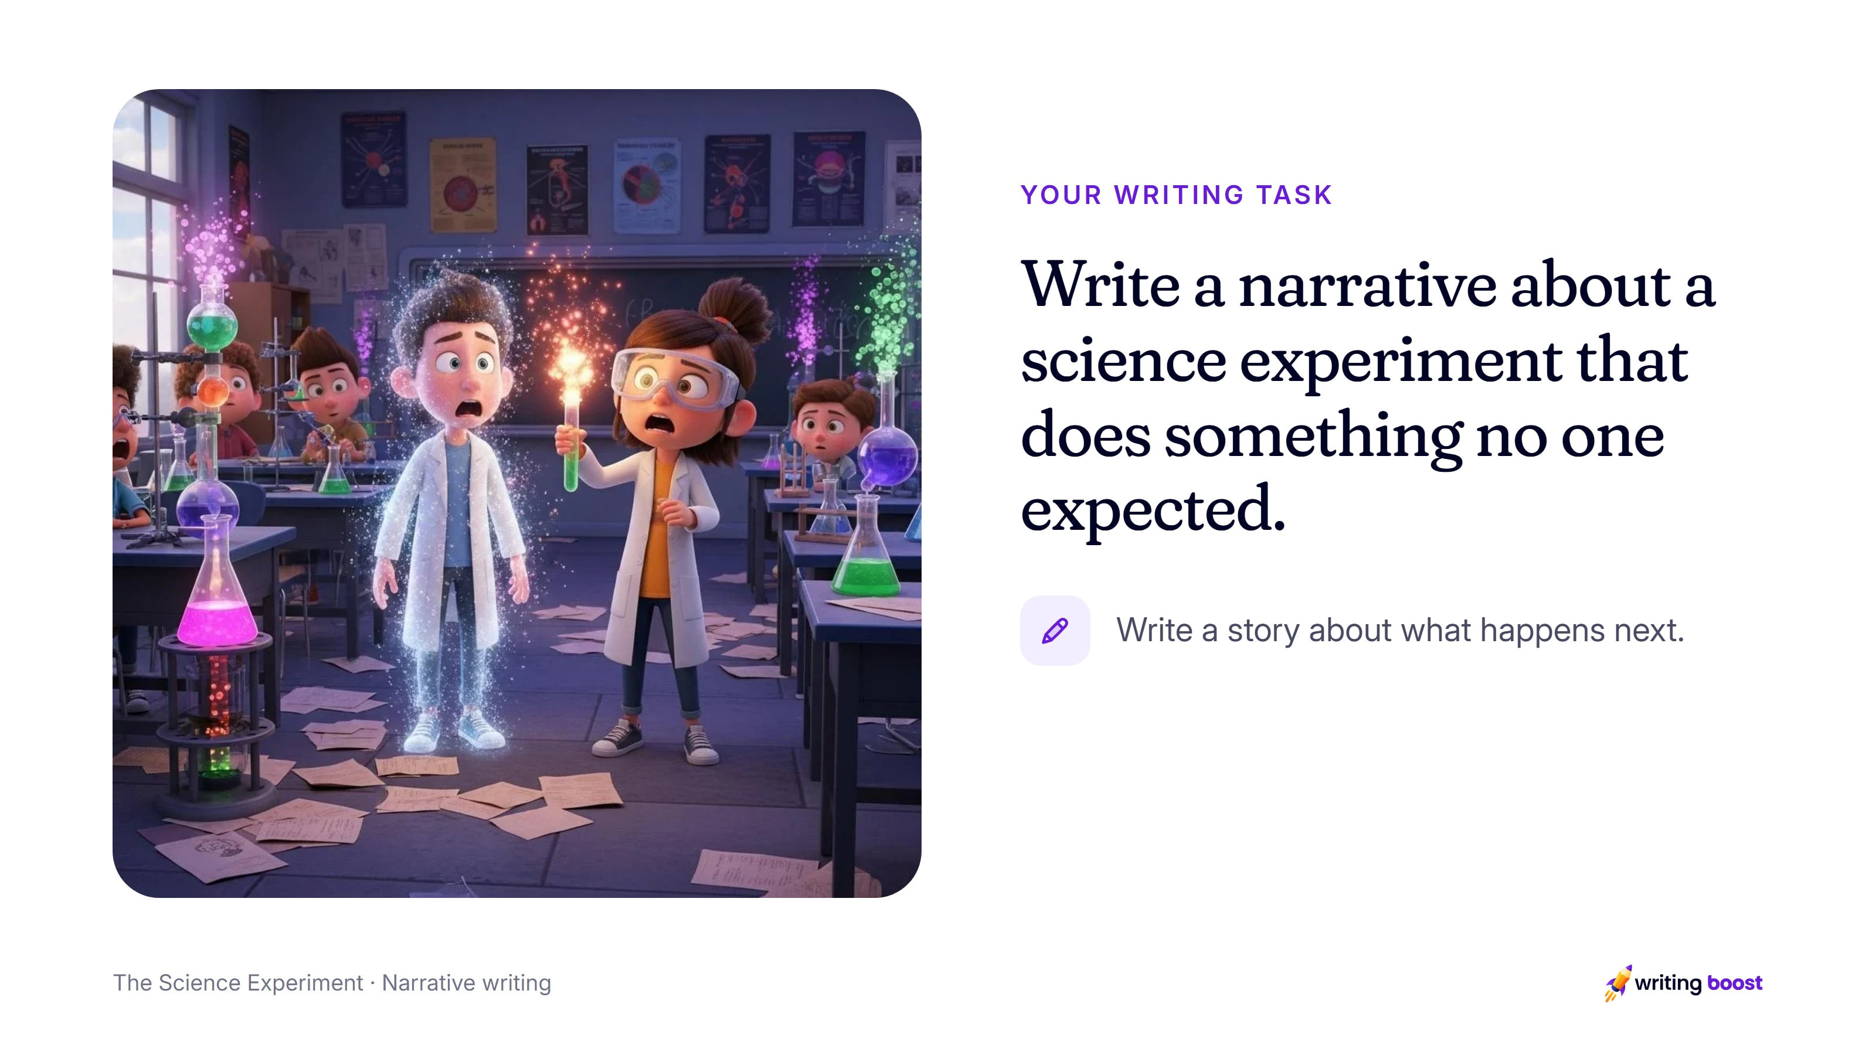
Notes:
Read the task aloud, then the instruction under it: write a story about what happens next.
Ask about an experiment students have done in class and what they expected to happen. Then ask what the most surprising result could be.

Slide 5
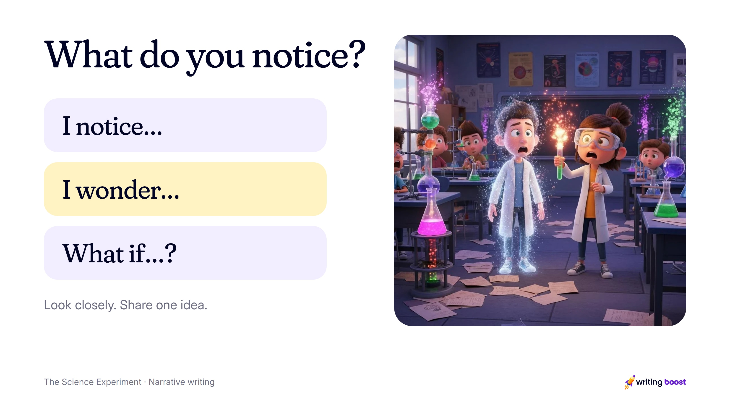
Notes:
Notice (5 min). Show the picture. Students say what they notice and what they wonder, then share one “what if” for a story.
Give them a quiet minute with the picture first.

Slide 6
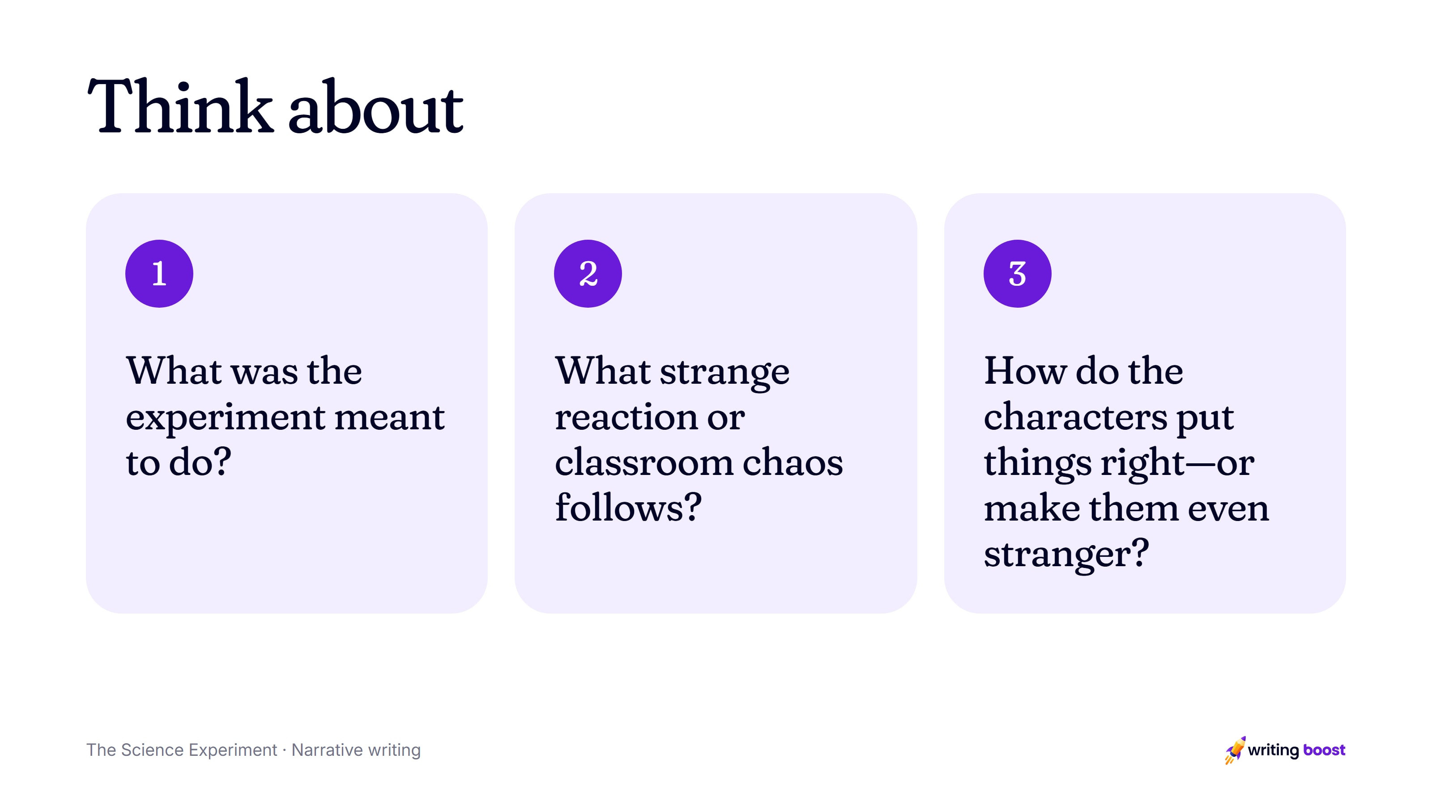
Notes:
Talk it through (10 min). Collect ideas for a character, a problem and an ending. Model a strong opening line, out loud.
Use these questions to grow a few ideas into a story.

Slide 7
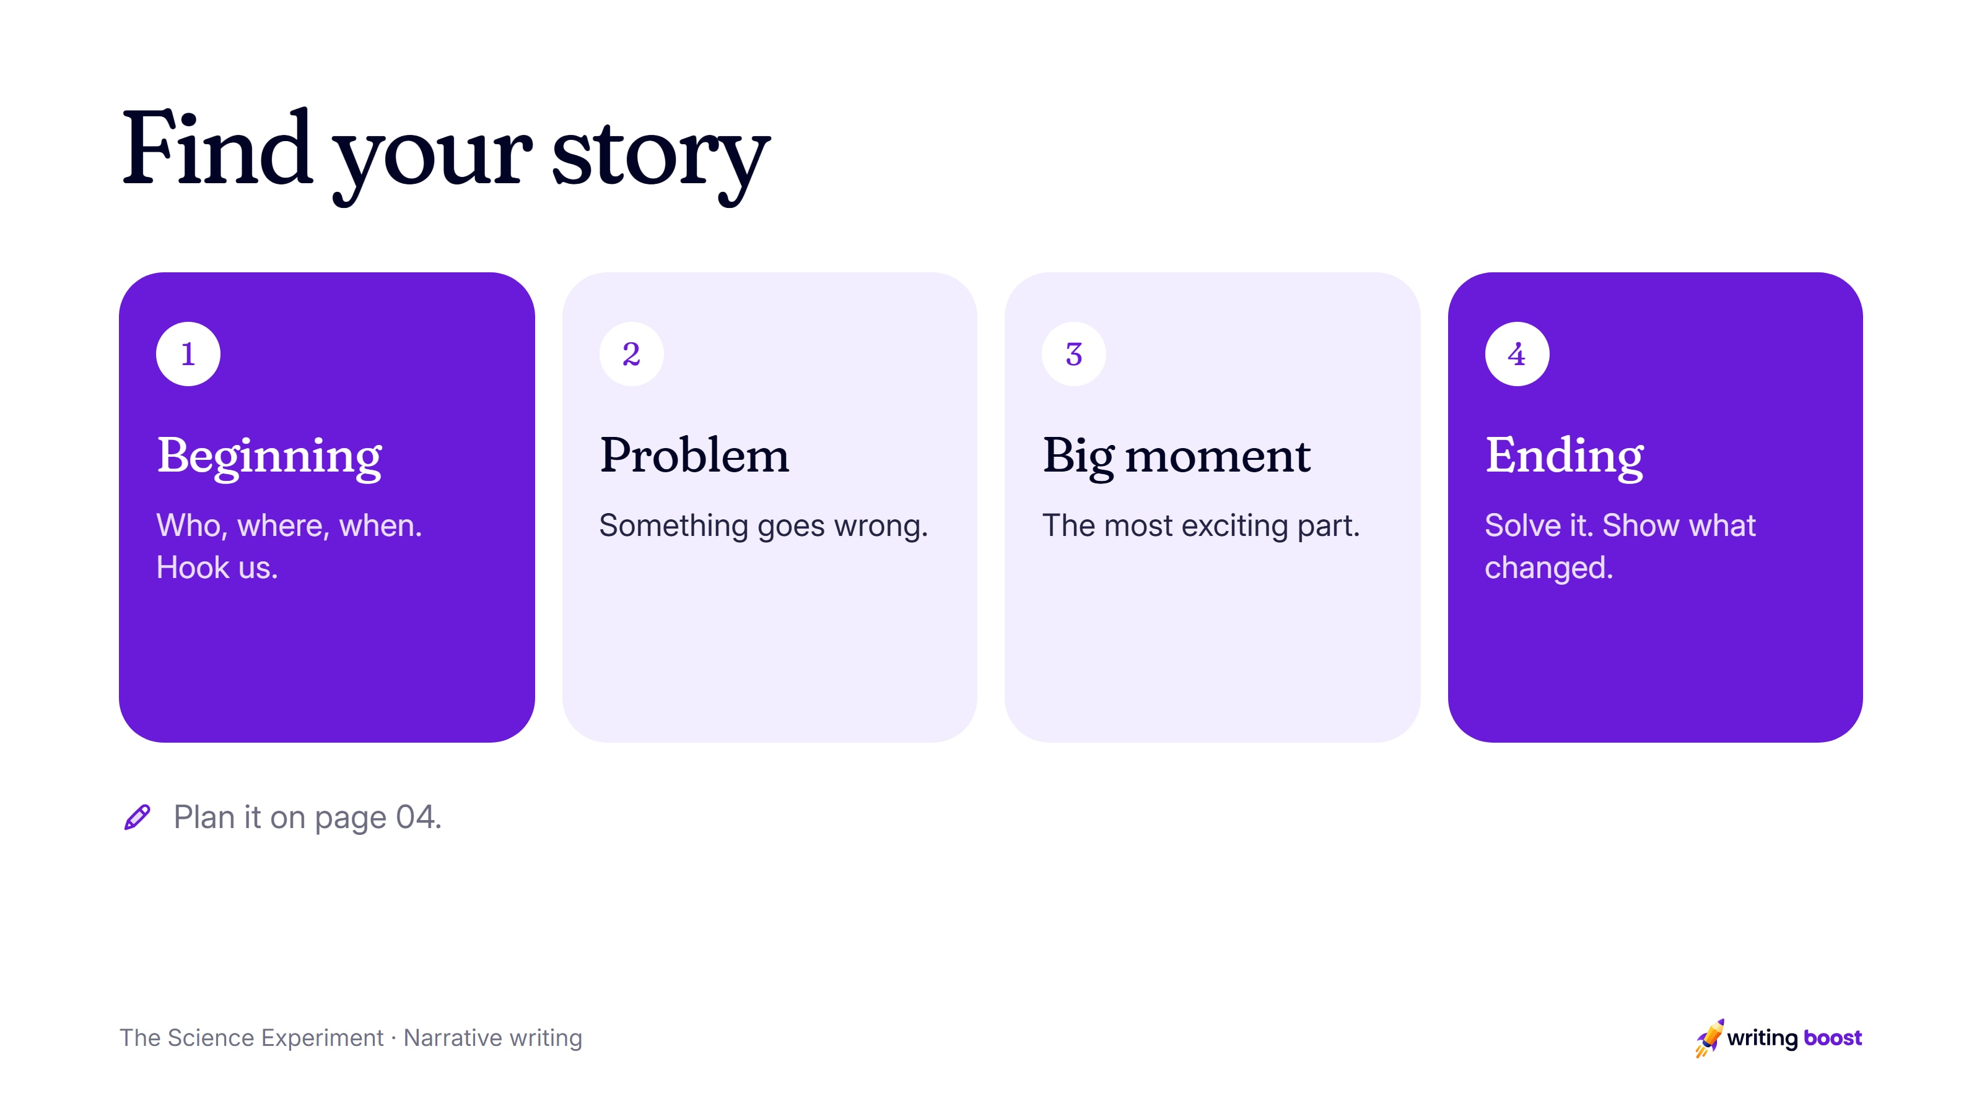
Notes:
Plan (5 min). Students plan their character, setting, problem, big moment and ending on page 04.
Support: Plan the experiment’s steps first, then decide which step goes wrong.
Extend: Use a science word or two correctly, and let the reader see the reaction through the character’s eyes.

Slide 8
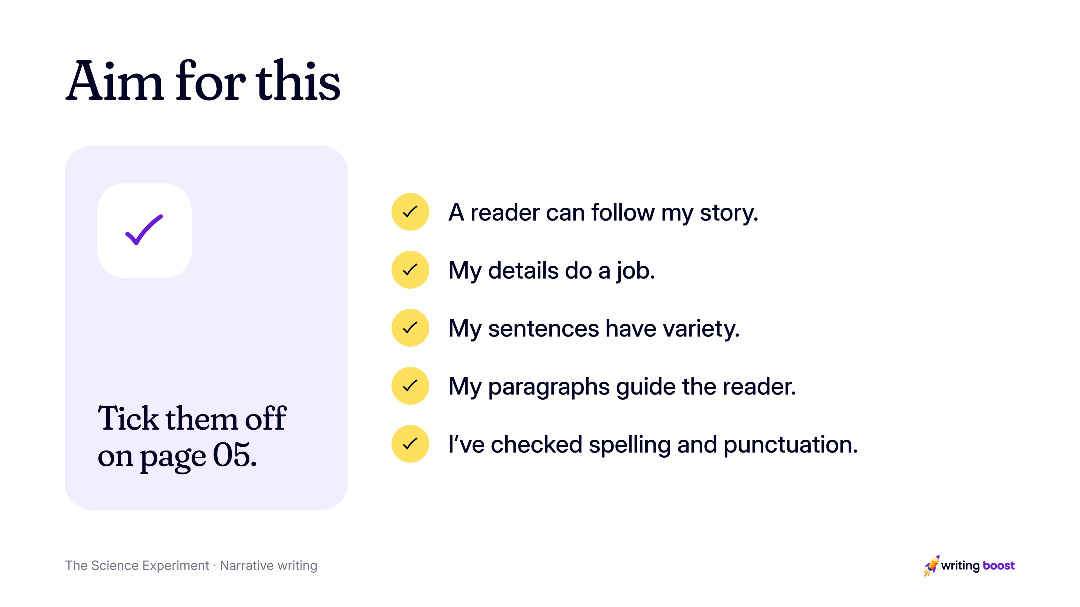
Notes:
These match the reread checklist on page 05 of the printable pack. Writing Boost marks writing on the ten NAPLAN writing criteria, so the feedback students get lines up with what you teach here.

Slide 9
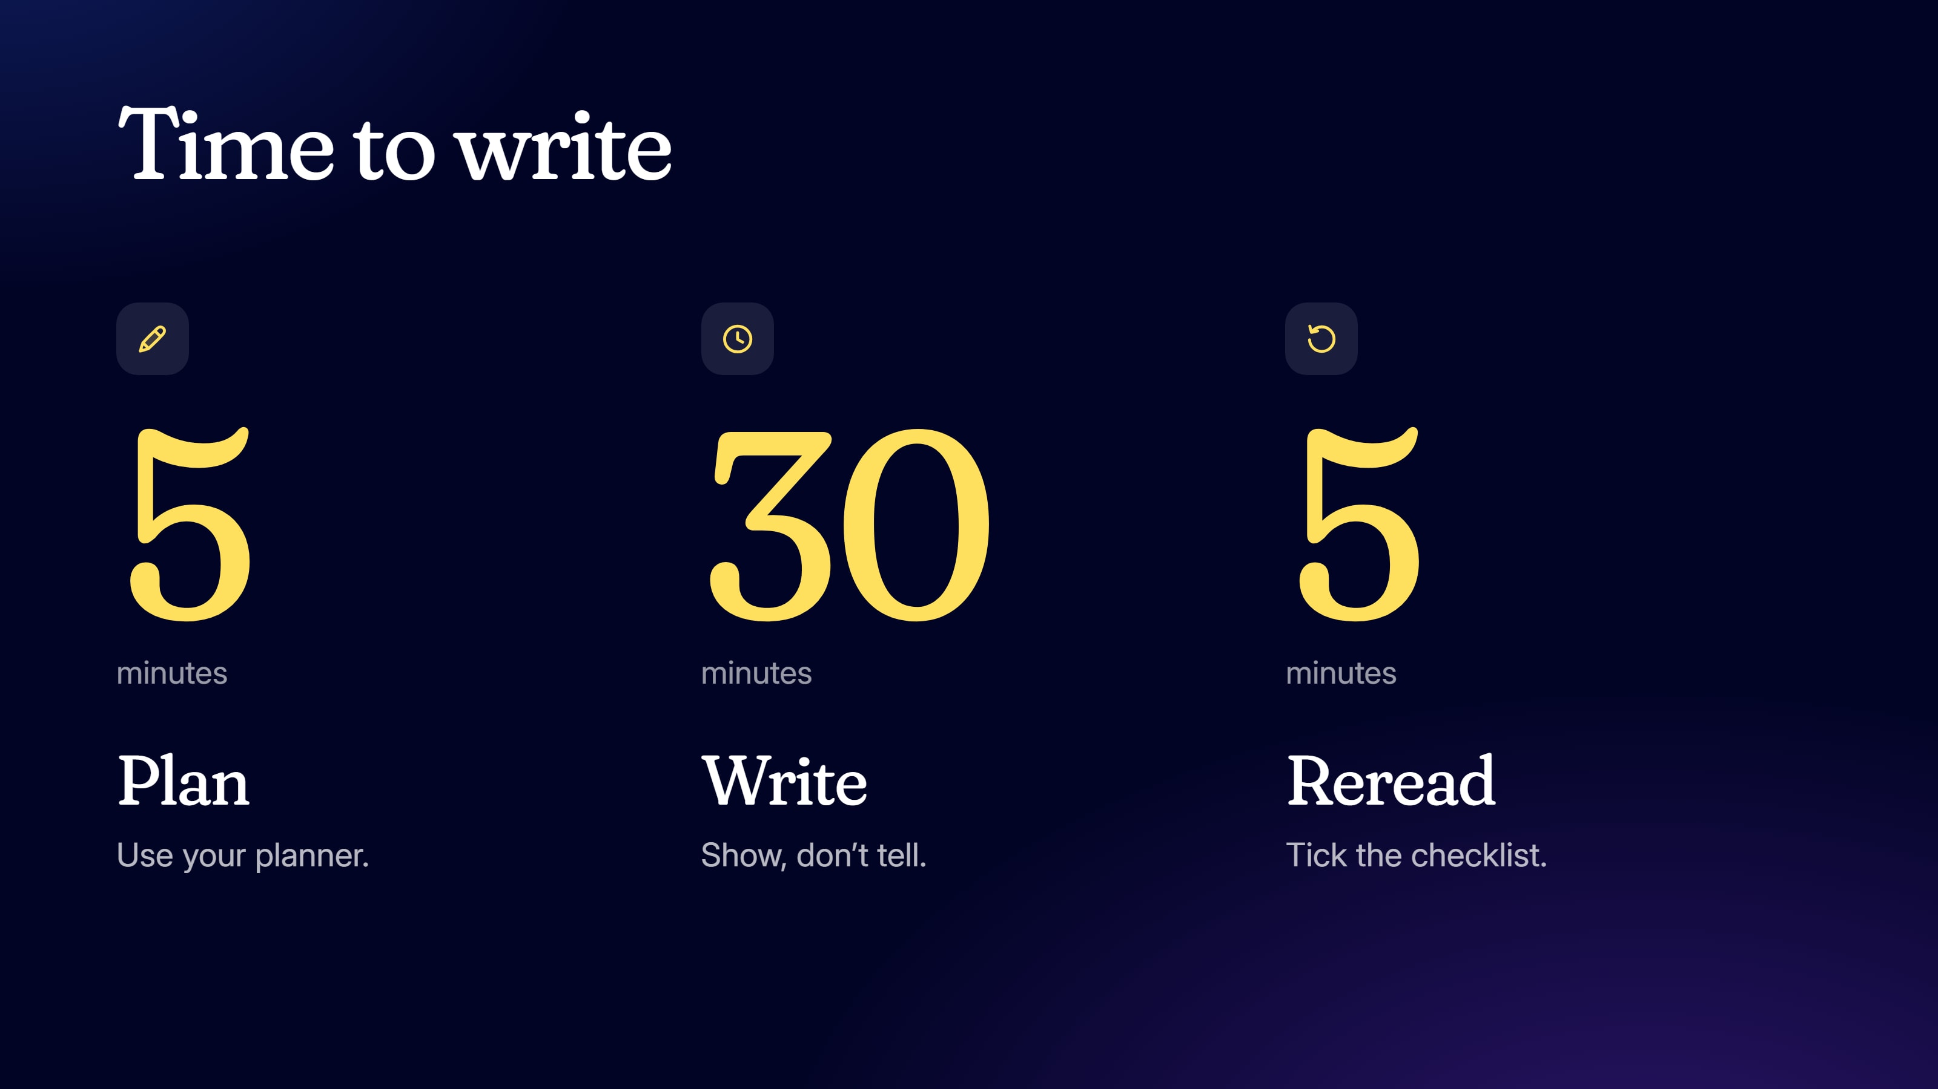
Notes:
Write (35 min). Write for 30 minutes, then reread for 5 with the checklist on page 05 and make one useful change.
Change the times to suit your class.

Slide 10
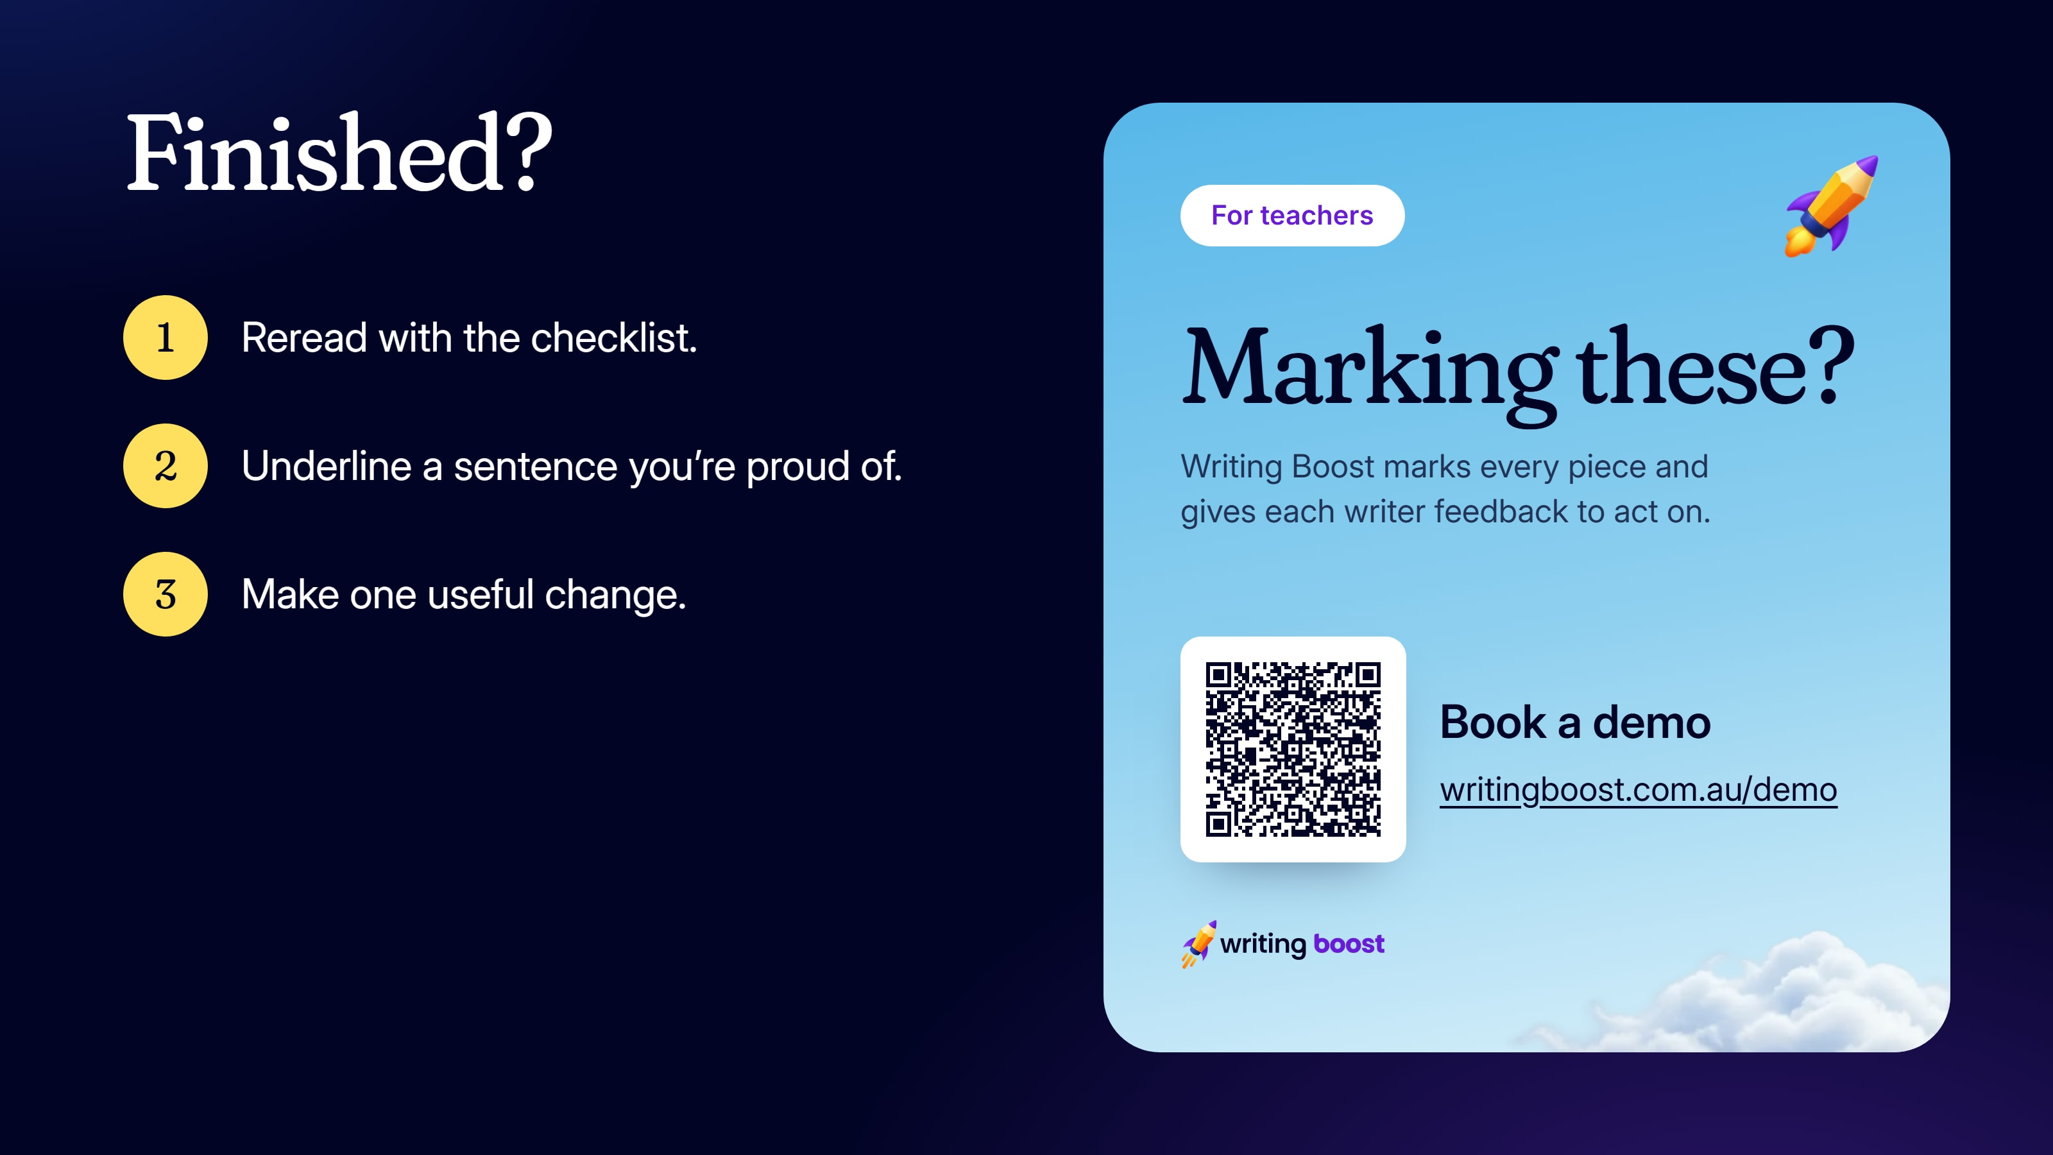
Notes:
Collect the writing when they're done.
To get every piece marked on the ten NAPLAN writing criteria, with feedback each student can act on, book a demo: https://writingboost.com.au/demo/?utm_source=prompt-pack&utm_medium=slides&utm_campaign=the-science-experiment&utm_content=last-slide

