Slide 1

Notes:
Save Our Playgrounds: a persuasive writing lesson for Years 3–9, about 55 minutes.
The next two slides are for you: they're set to be skipped when you present.
1. Take a stand (5 min)
2. Talk it through (10 min)
3. Plan (5 min)
4. Write (35 min)
The printable pack has the task sheet, a planner and a reread checklist to go with these slides.

Slide 2
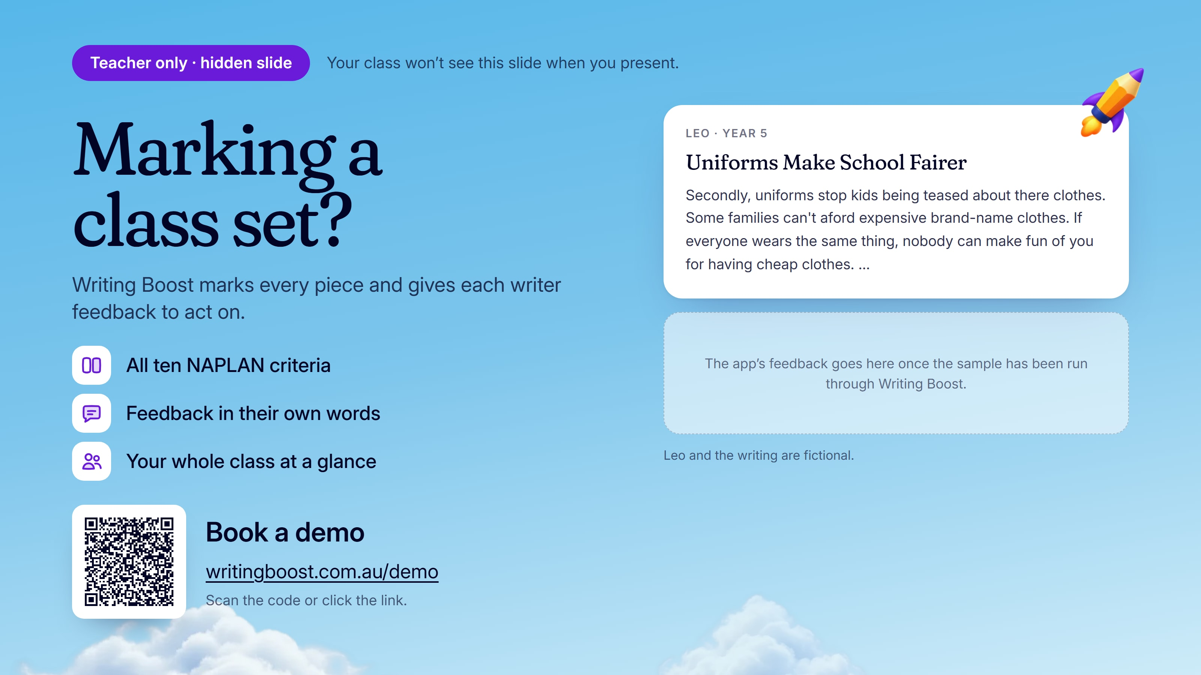
Notes:
This slide is for you, and is set to be skipped when you present.
Leo's persuasive piece is a sample. To see your own class's writing marked on the ten NAPLAN writing criteria, book a demo: https://writingboost.com.au/demo/?utm_source=prompt-pack&utm_medium=slides&utm_campaign=save-our-playgrounds&utm_content=hidden-slide

Slide 3


Notes:
This slide is for you, and is set to be skipped when you present.
Click play: How Writing Boost works, with captions. If it won't play here (Google Slides plays only YouTube and Drive videos), watch it online: https://writingboost.com.au/media/homepage-film/writing-boost-homepage-film-v3-short-jacaranda-web-720.mp4

Slide 4
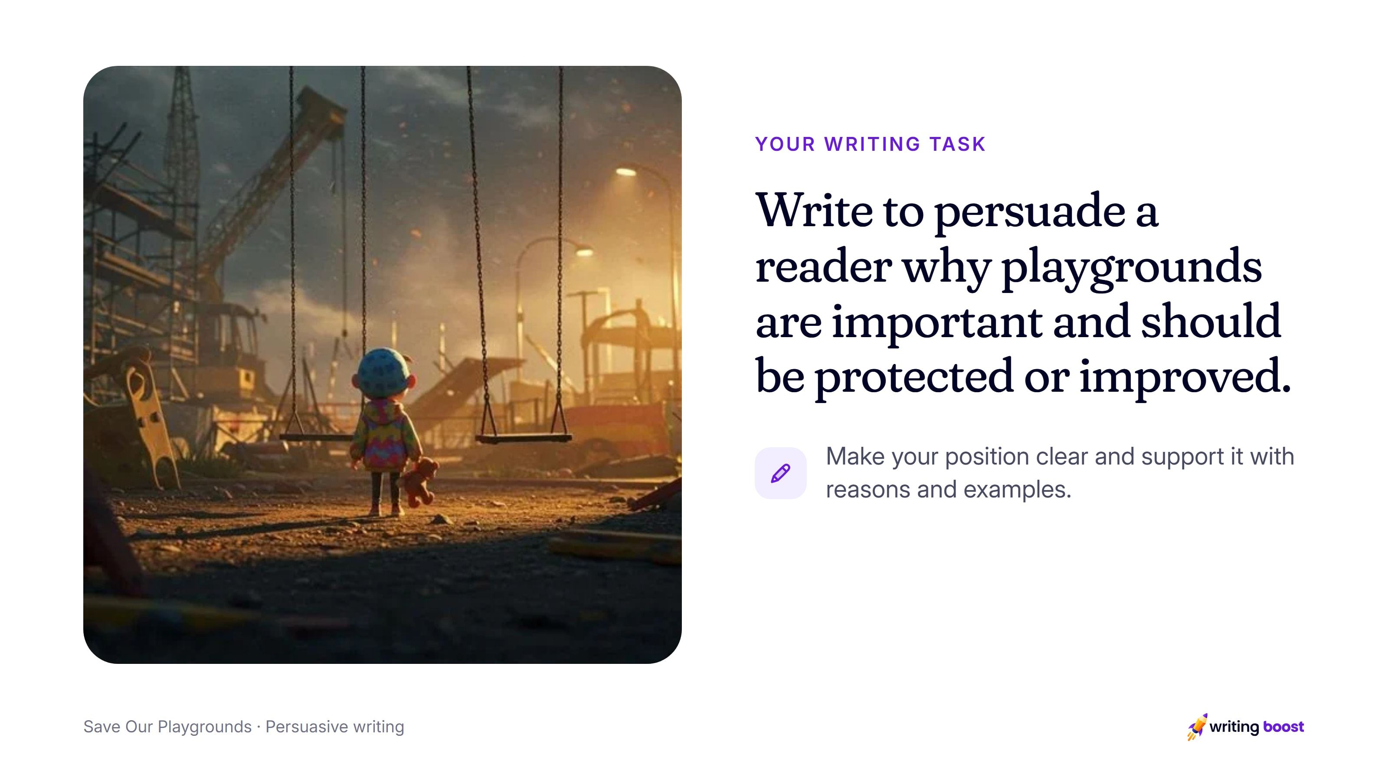
Notes:
Read the task aloud, then the instruction under it: make your position clear and support it with reasons and examples.
Start with a playground students know. Ask who uses it and what would be lost without it, and record their answers as reasons and examples.

Slide 5
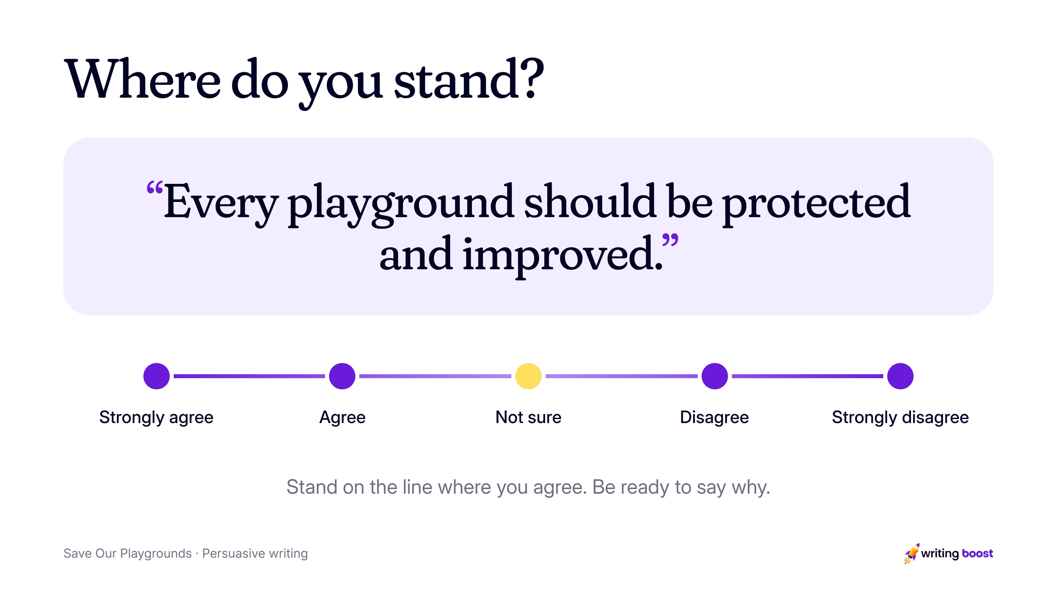
Notes:
Take a stand (5 min). Show the picture and read the statement aloud. Students stand along a line from strongly agree to strongly disagree, then a few explain where they stand and why.
Ask two or three students near each end, and one in the middle, for a reason.

Slide 6
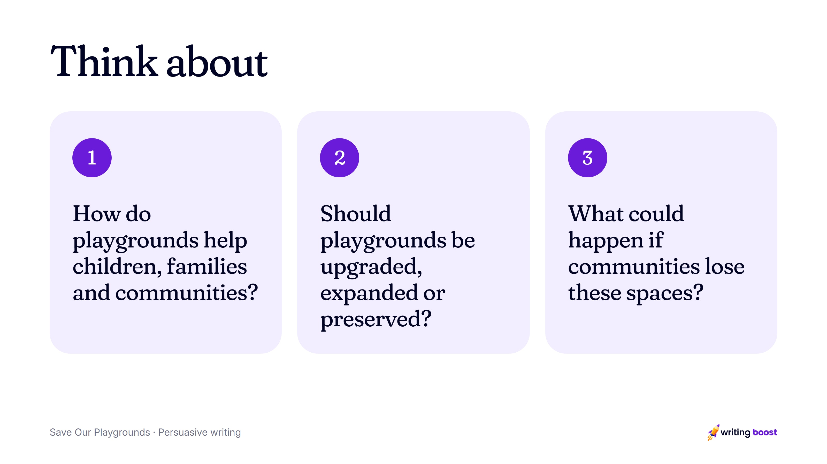
Notes:
Talk it through (10 min). List reasons on both sides together. Model one reason with an example, out loud, so students hear how it fits together.
Use these questions to draw out reasons on both sides.

Slide 7
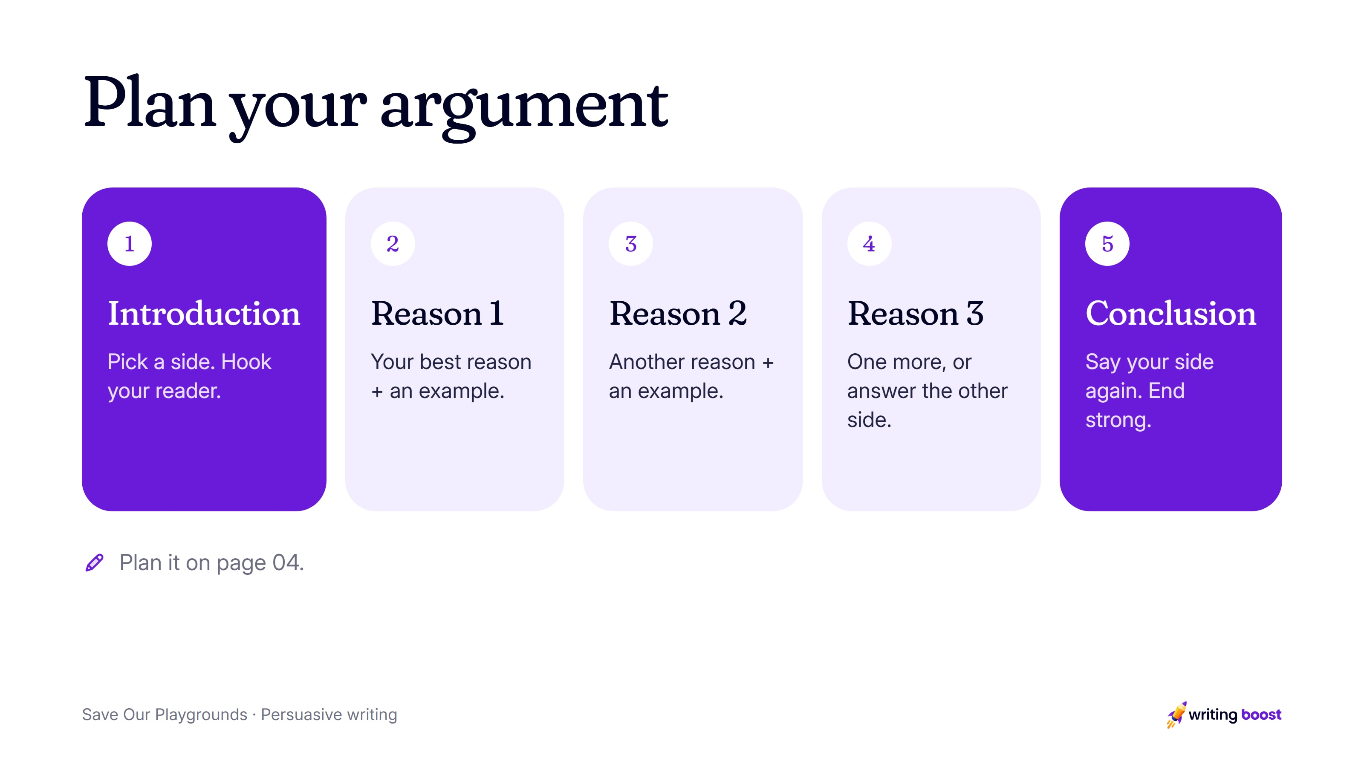
Notes:
Plan (5 min). Students choose a side and plan an opening, three reasons and a conclusion on page 04.
Support: Choose your reader first, such as the local council, and write each reason as if you were speaking to them.
Extend: Use a short scene from a real playground to make one reason vivid for the reader.

Slide 8
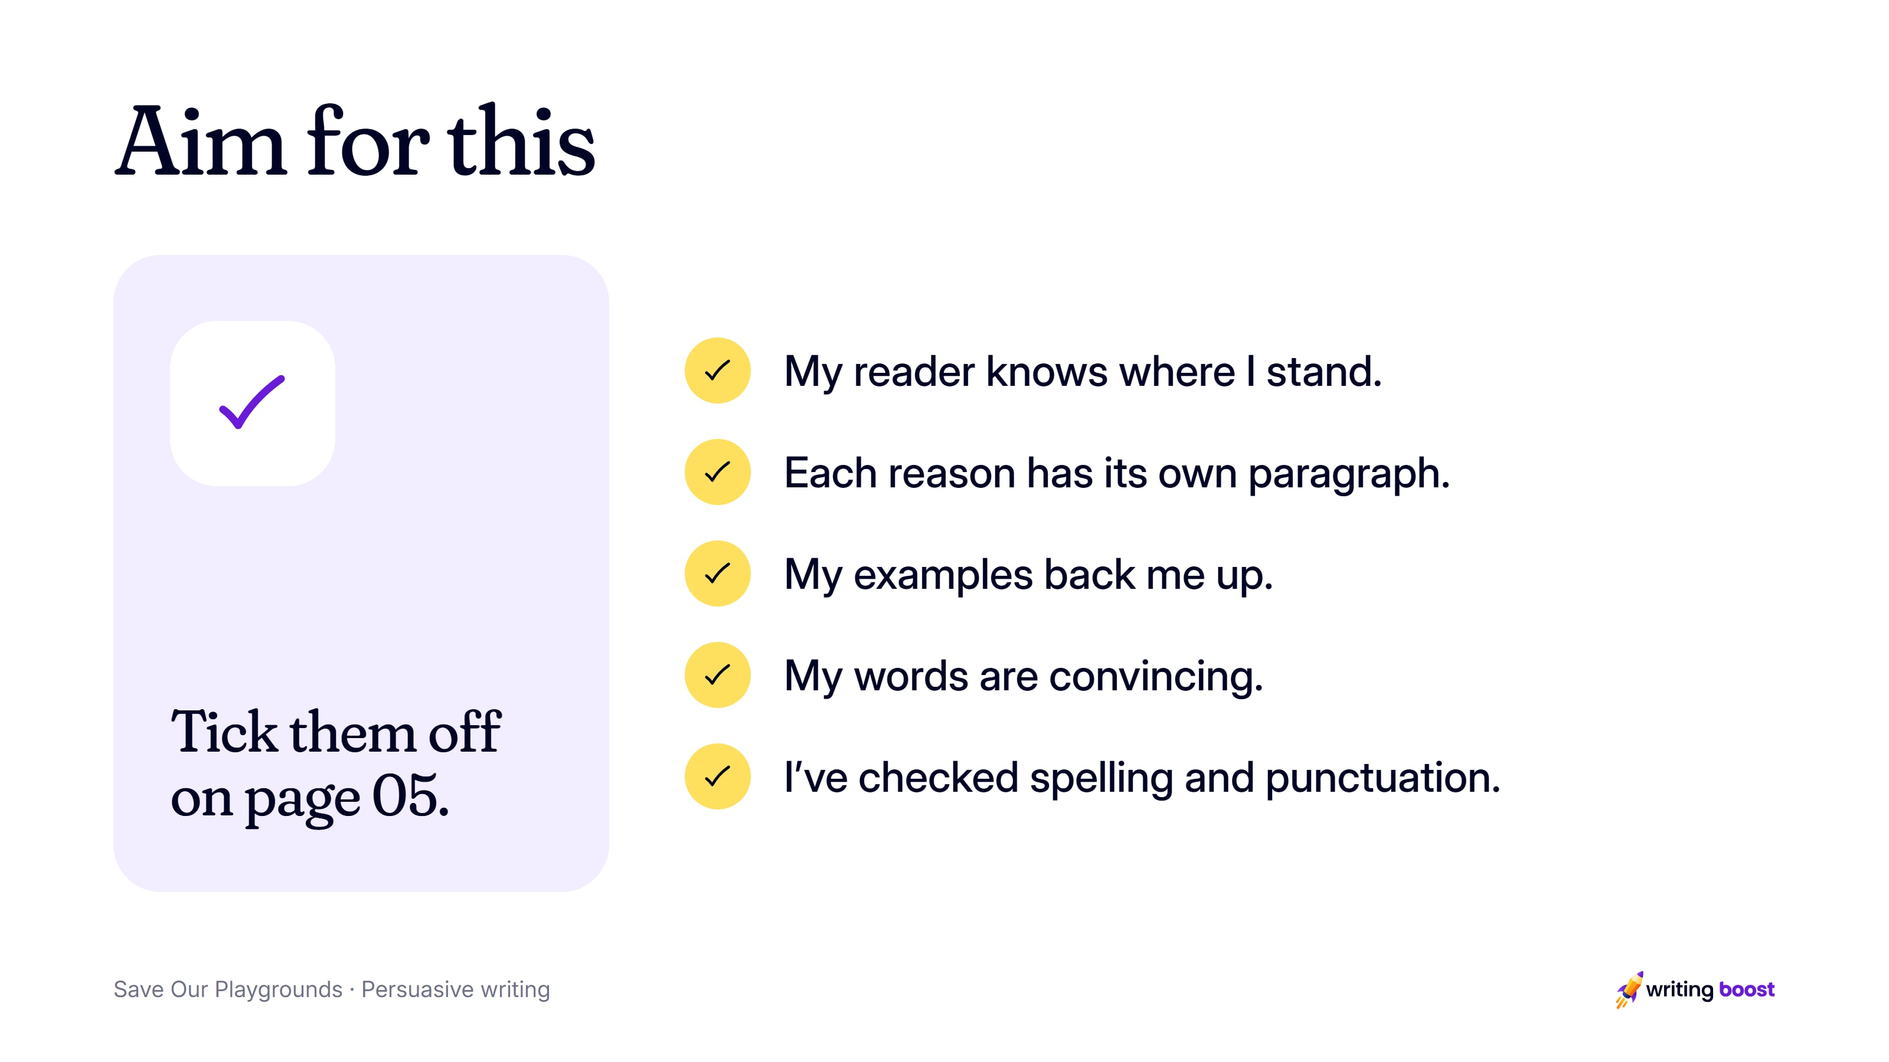
Notes:
These match the reread checklist on page 05 of the printable pack. Writing Boost marks writing on the ten NAPLAN writing criteria, so the feedback students get lines up with what you teach here.

Slide 9
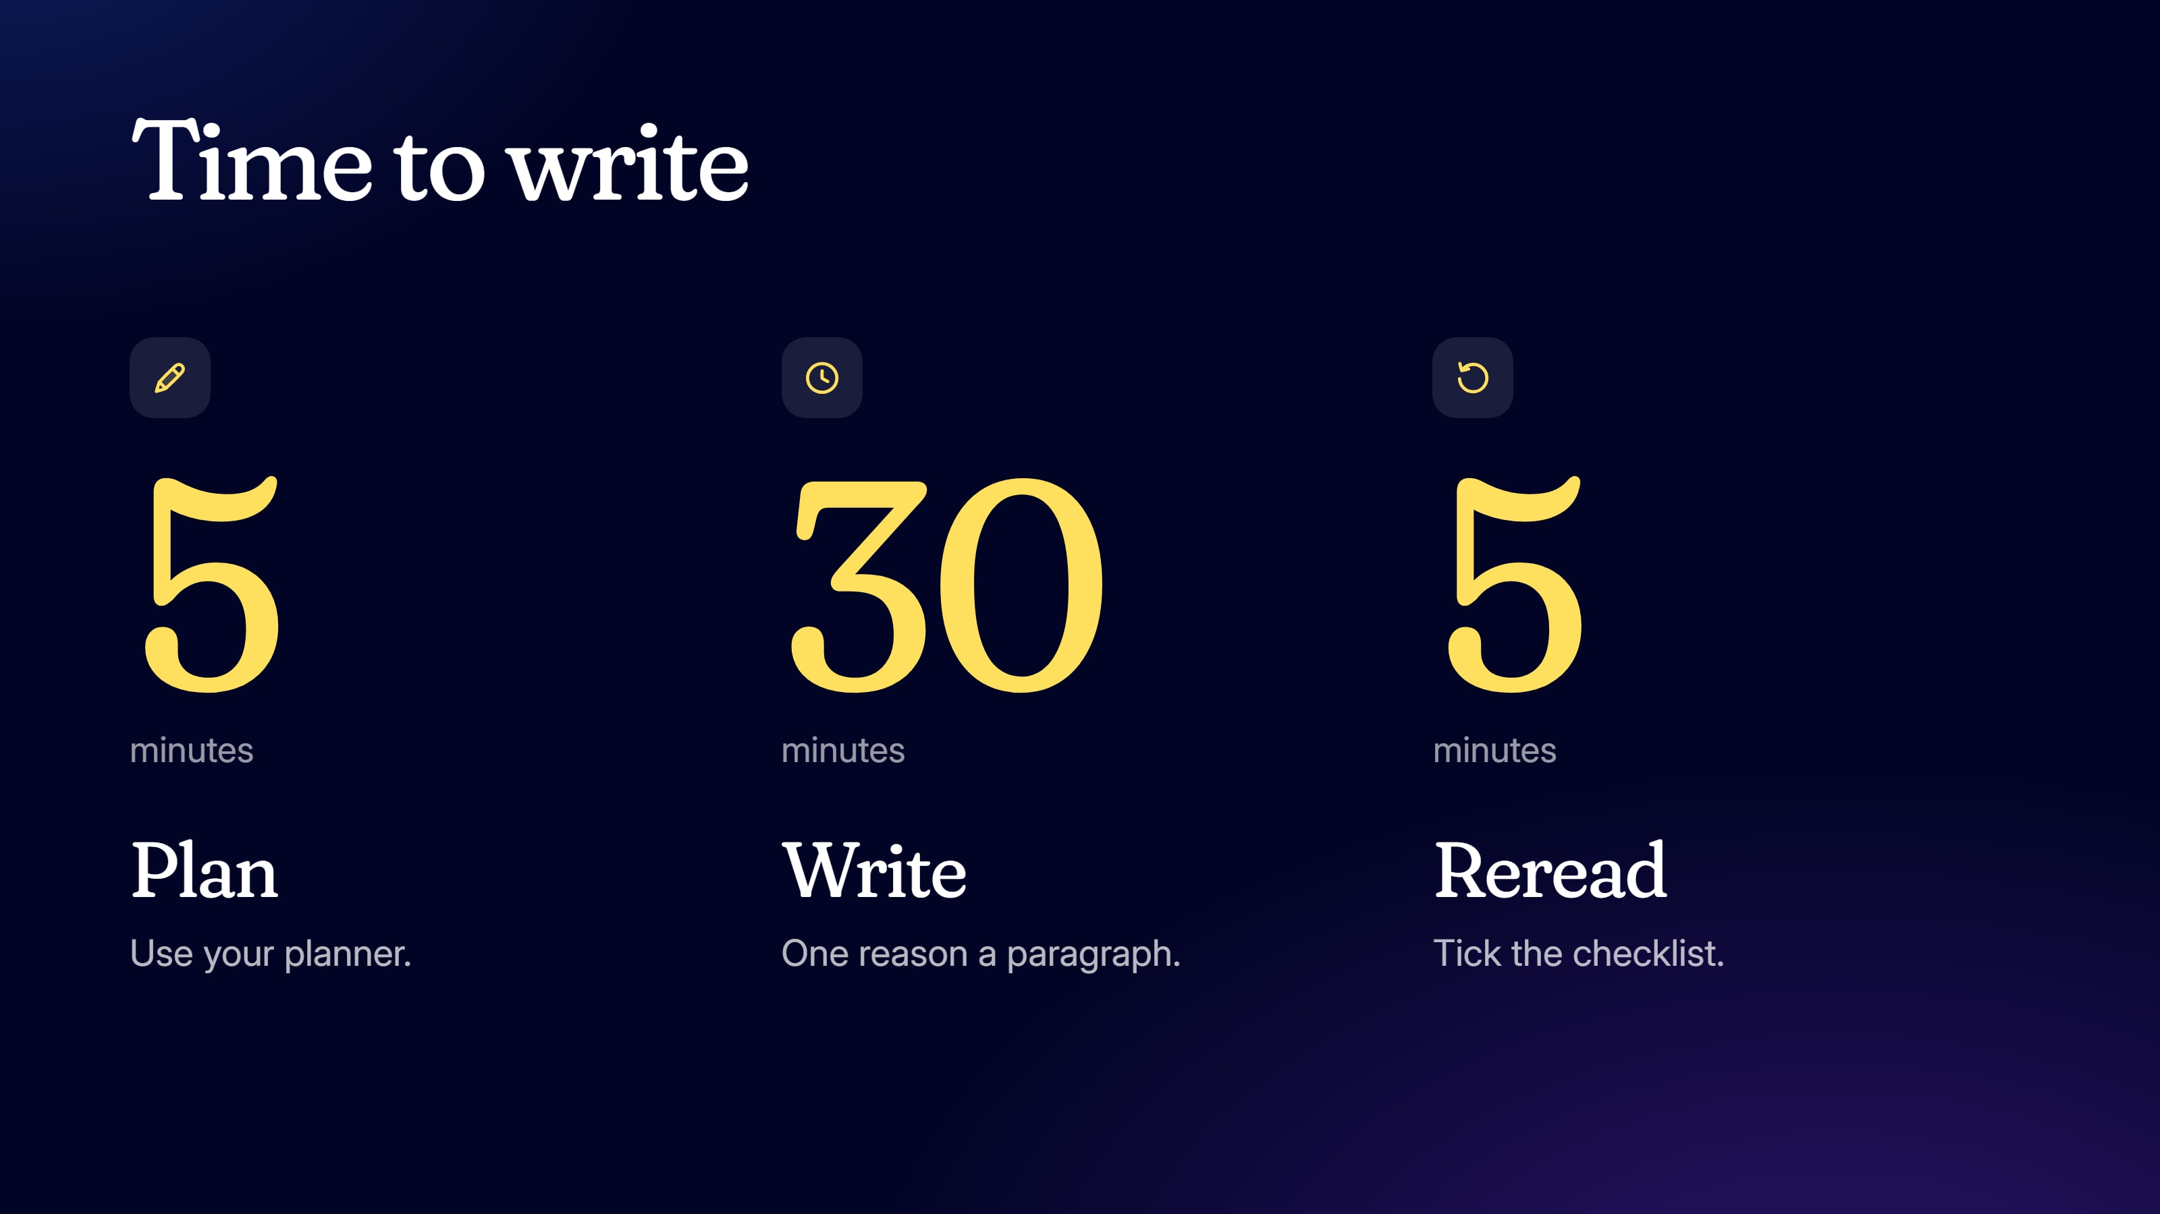
Notes:
Write (35 min). Write for 30 minutes, then reread for 5 with the checklist on page 05 and make one useful change.
Change the times to suit your class.

Slide 10
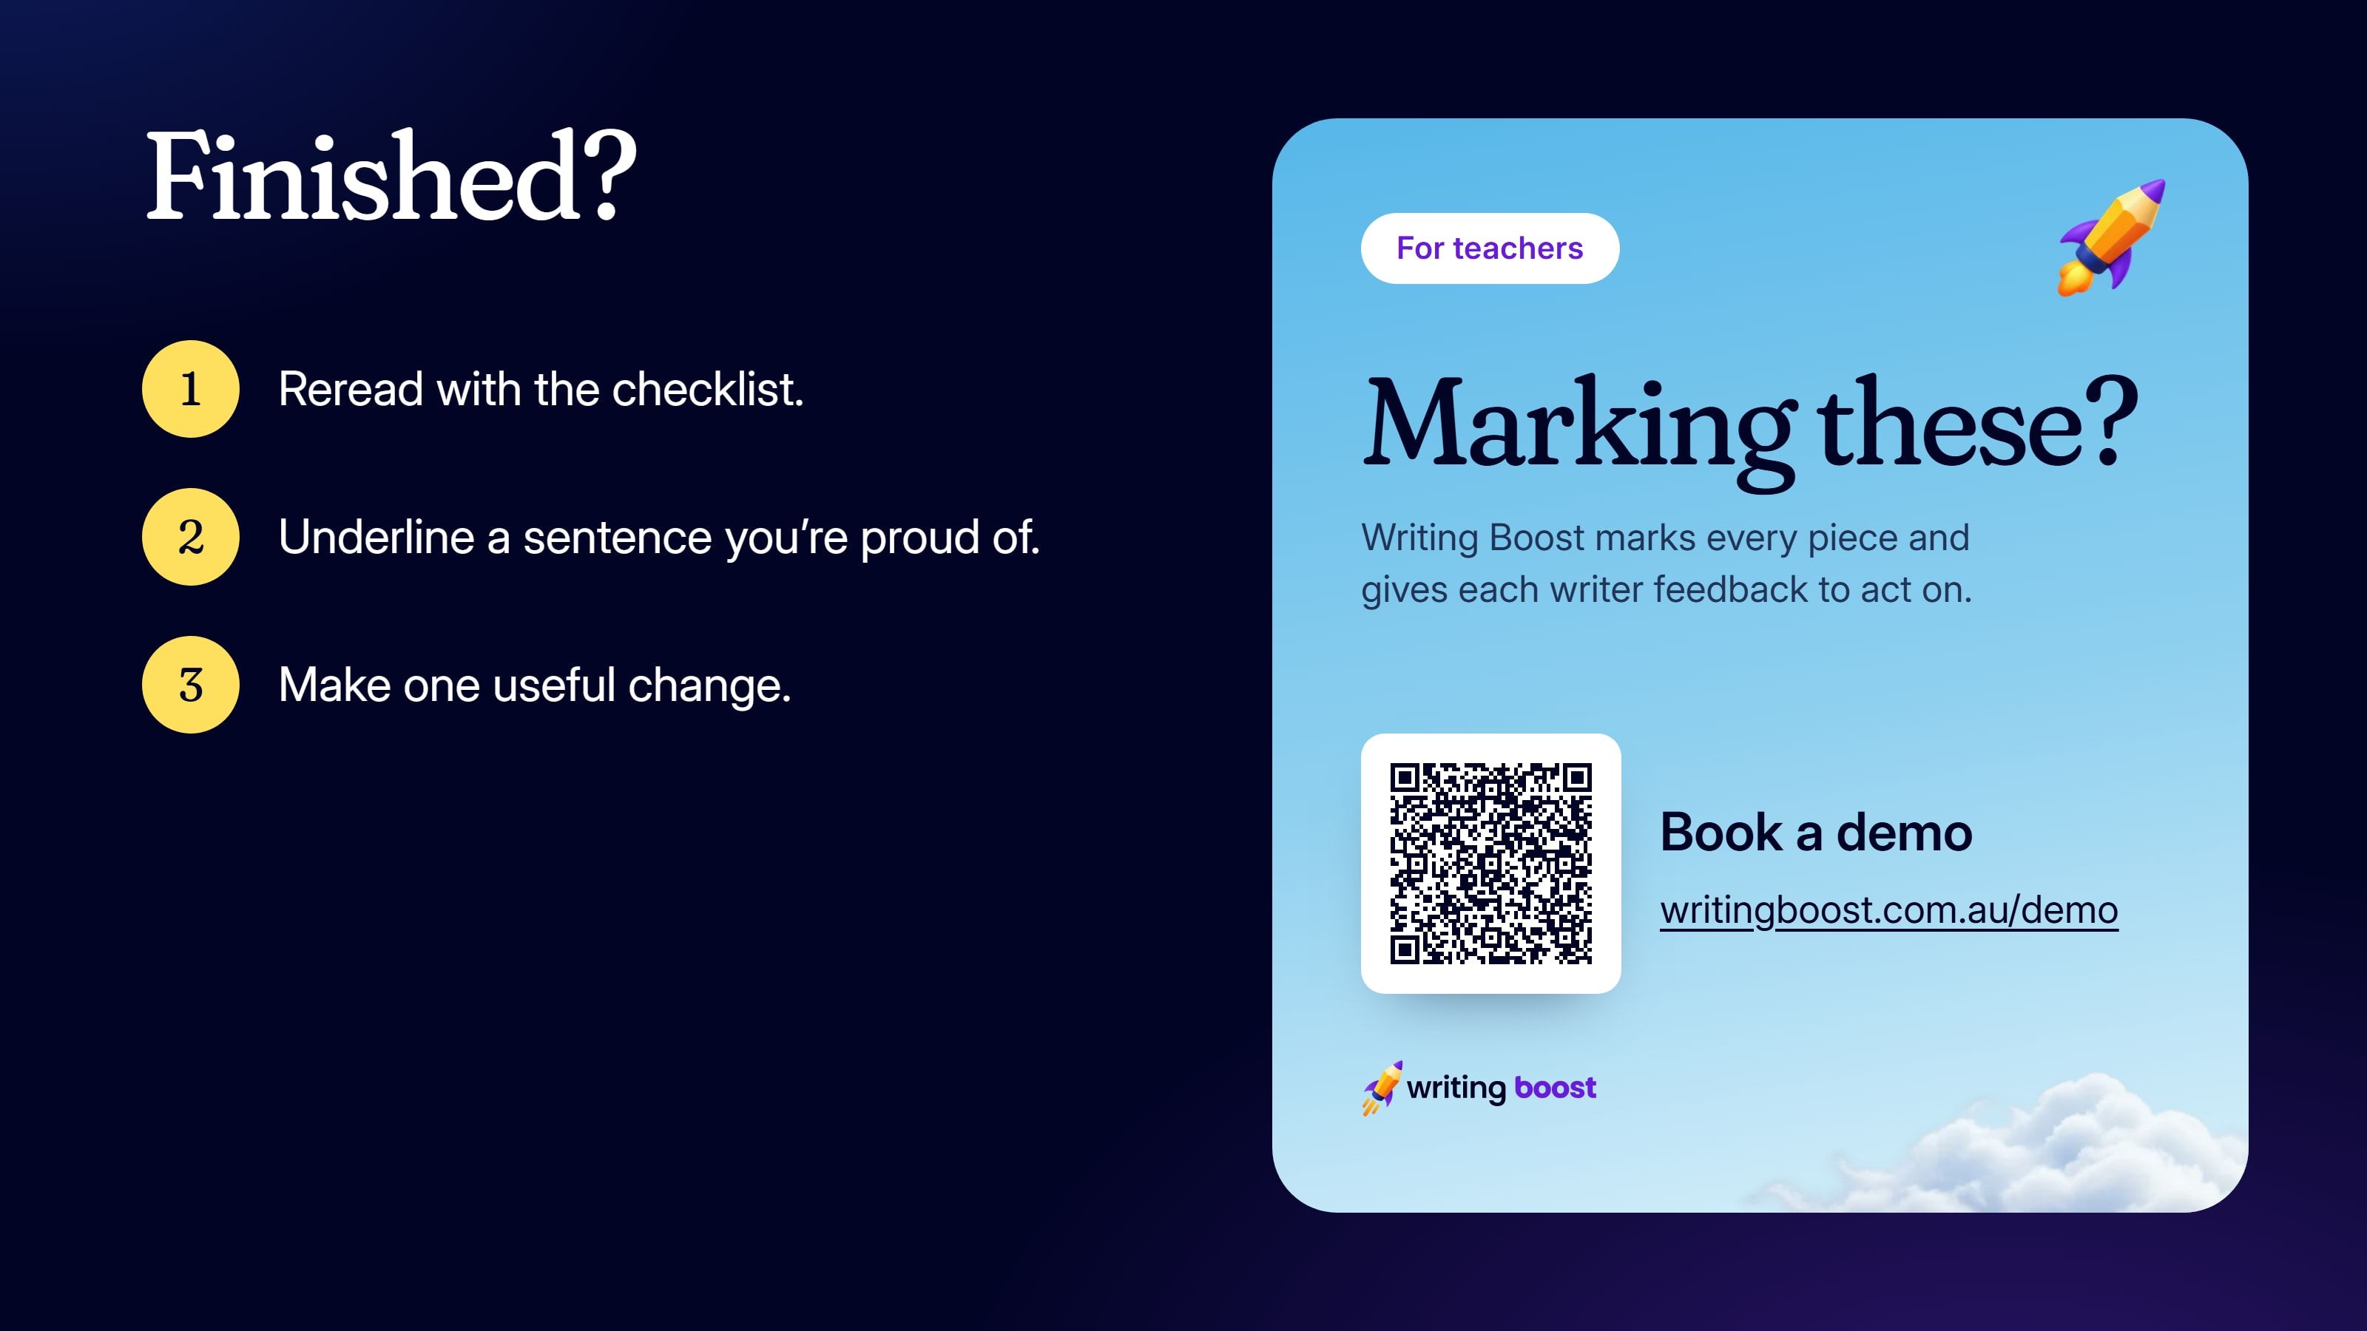
Notes:
Collect the writing when they're done.
To get every piece marked on the ten NAPLAN writing criteria, with feedback each student can act on, book a demo: https://writingboost.com.au/demo/?utm_source=prompt-pack&utm_medium=slides&utm_campaign=save-our-playgrounds&utm_content=last-slide

